Slide 1
Preliminary Findings Team 5
Nick Kamarianakis
Douglas Raymond
Jacob Hawley
Neal Traynor
Will Rose

Slide 2
Overview
Materials
Shape and size
Frame
Locking mechanism
Interior features

Slide 3
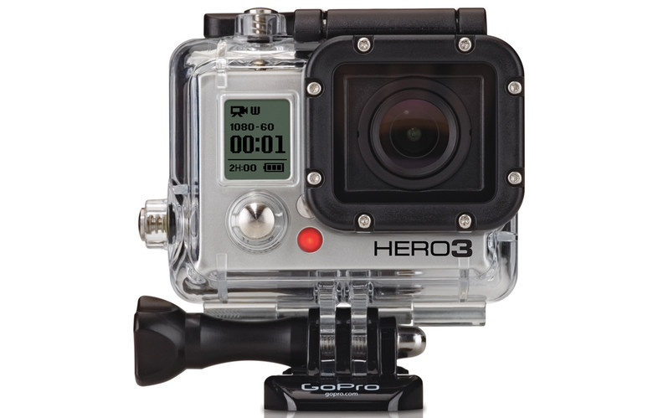

Materials
Housing Electrical Components
Glass Filled Polycarbonate
Lightweight, Impact resistant
Outer Panels
Fiberglass Reinforced Polyester
Scratch Resistant, Easy to mold

Slide 4
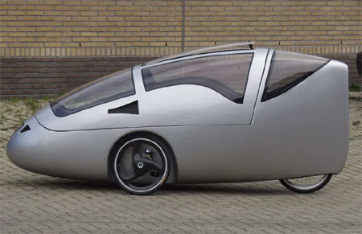
Shape and Size
Roughly 278L x 85W x 120H cm
Specifically tailored to the size of a Canadian bike lane
Aerodynamics will be carefully considered; making sure the bicycle weight will be efficient for the seasons and tasks provided

Slide 5
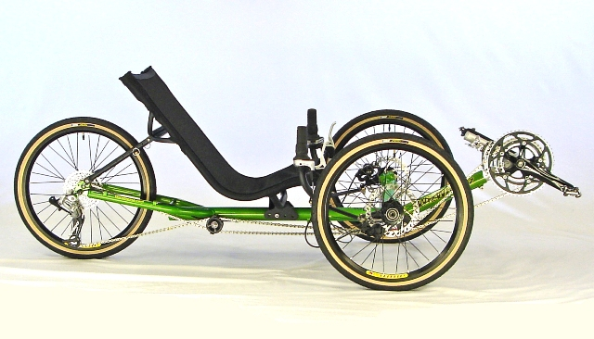
Frame
Force Distribution - Wheel base

Slide 6
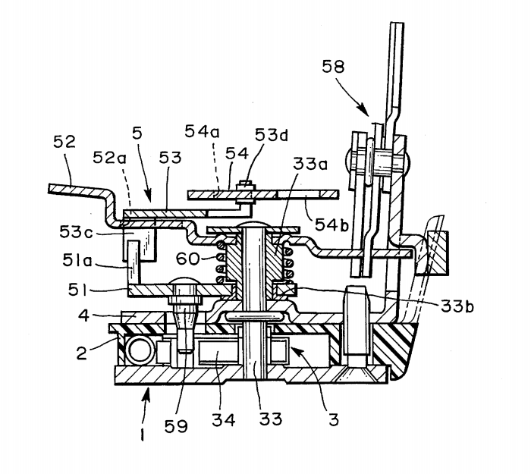
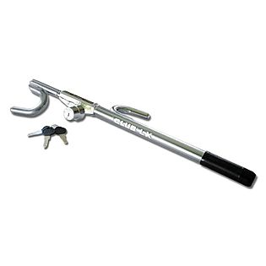
Locking Mechanism
Additional options
A compact and effective design is essential

Slide 7
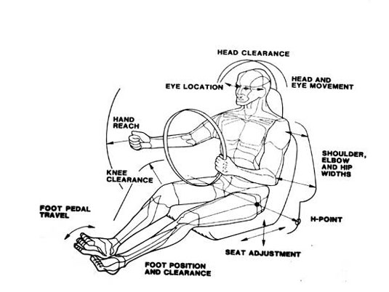
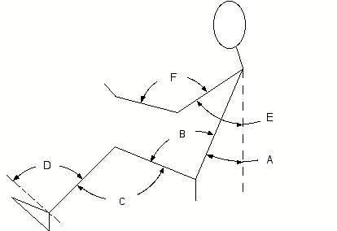
Interior Features
H-Point and Comfort
Posture Angles and Adjustability

Slide 8
Conclusion
Thank You for Listening!
Questions?

